Slide 1
Building Harmonies
Colour Schemes

Slide 2
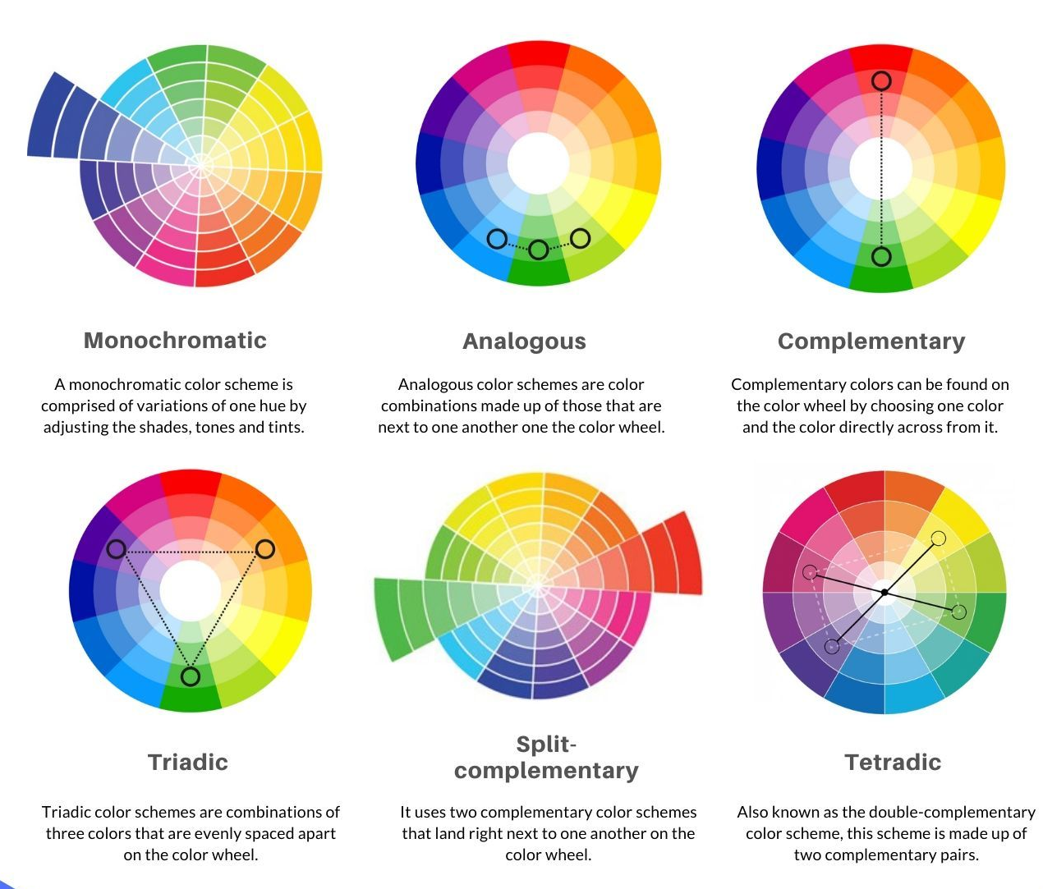
Colour Schemes
Monochromatic
Analogous
Complementary
Triadic
Split Complementary
Double Complementary
Notes:
Here are six basic colour relationship concepts that can be applied to an inﬁnite number of colour combinations. These are the basic ones, there are more colour schemes you can explore.
Complementary
Split Complementary
Double Complementary
Analogous
Triadic
Monochromatic
Image from: https://sl.bing.net/cZiIAtrhVEi

Slide 3
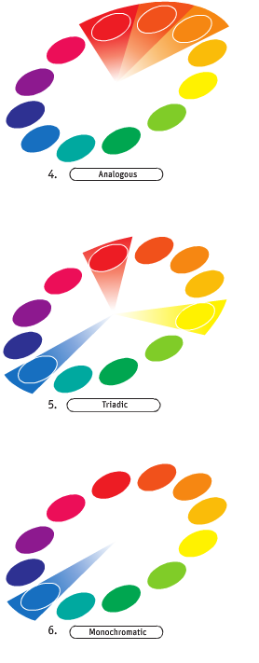
Colour Schemes
Monochromatic
Notes:
Monochromatic
These are colour schemes made up of shades and tints of a single colour. Use one hue and explore variety in saturation and lightness to form an allied combination of similar colours.

Slide 4
Colour Schemes
Analogous
Notes:
Analogous
These are combinations of two or more colours that are spaced equally from each other on the colour wheel. These colours have similar light ray wavelengths, so they are easiest on the eye.

Slide 5
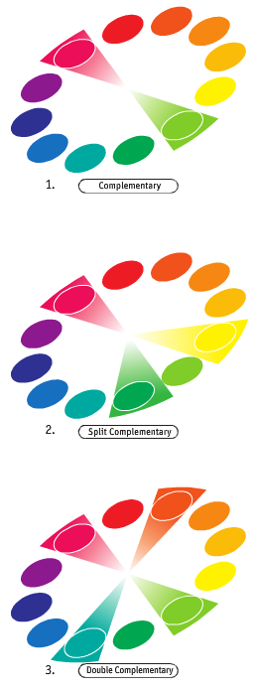
Colour Schemes
Complementary
Notes:
Complementary
These are colour pairs that are directly opposite each other on the colour wheel. They represent the most contrasting relationships. The use of two complementary colours will cause a visual vibration and excite the eye.

Slide 6
Colour Schemes
Triadic
Notes:
Triadic
These are combinations of any three colours that are spaced evenly around the colour wheel. Triads with primaries are garish, but secondary and tertiary triads provide softer contrast. Triads in which two of the colours share a common primary (e.g., purple and orange share red) may seem more pleasing.

Slide 7
Colour Schemes
Split Complementary
Notes:
Split Complementary
These are the three-colour schemes in which one colour is accompanied by two others that are spaced equally from the ﬁrst colour’s complement. The contrast is toned down somewhat, providing a more sophisticated relationship.

Slide 8
Colour Schemes
Double Complementary
Notes:
Double Complementary
This is the combination of two pairs of complementary colours. As complements increase the apparent intensity of each other, not all colour sets will be pleasing. Avoid using equal volumes of the four colours to make the scheme less jarring.

Slide 9
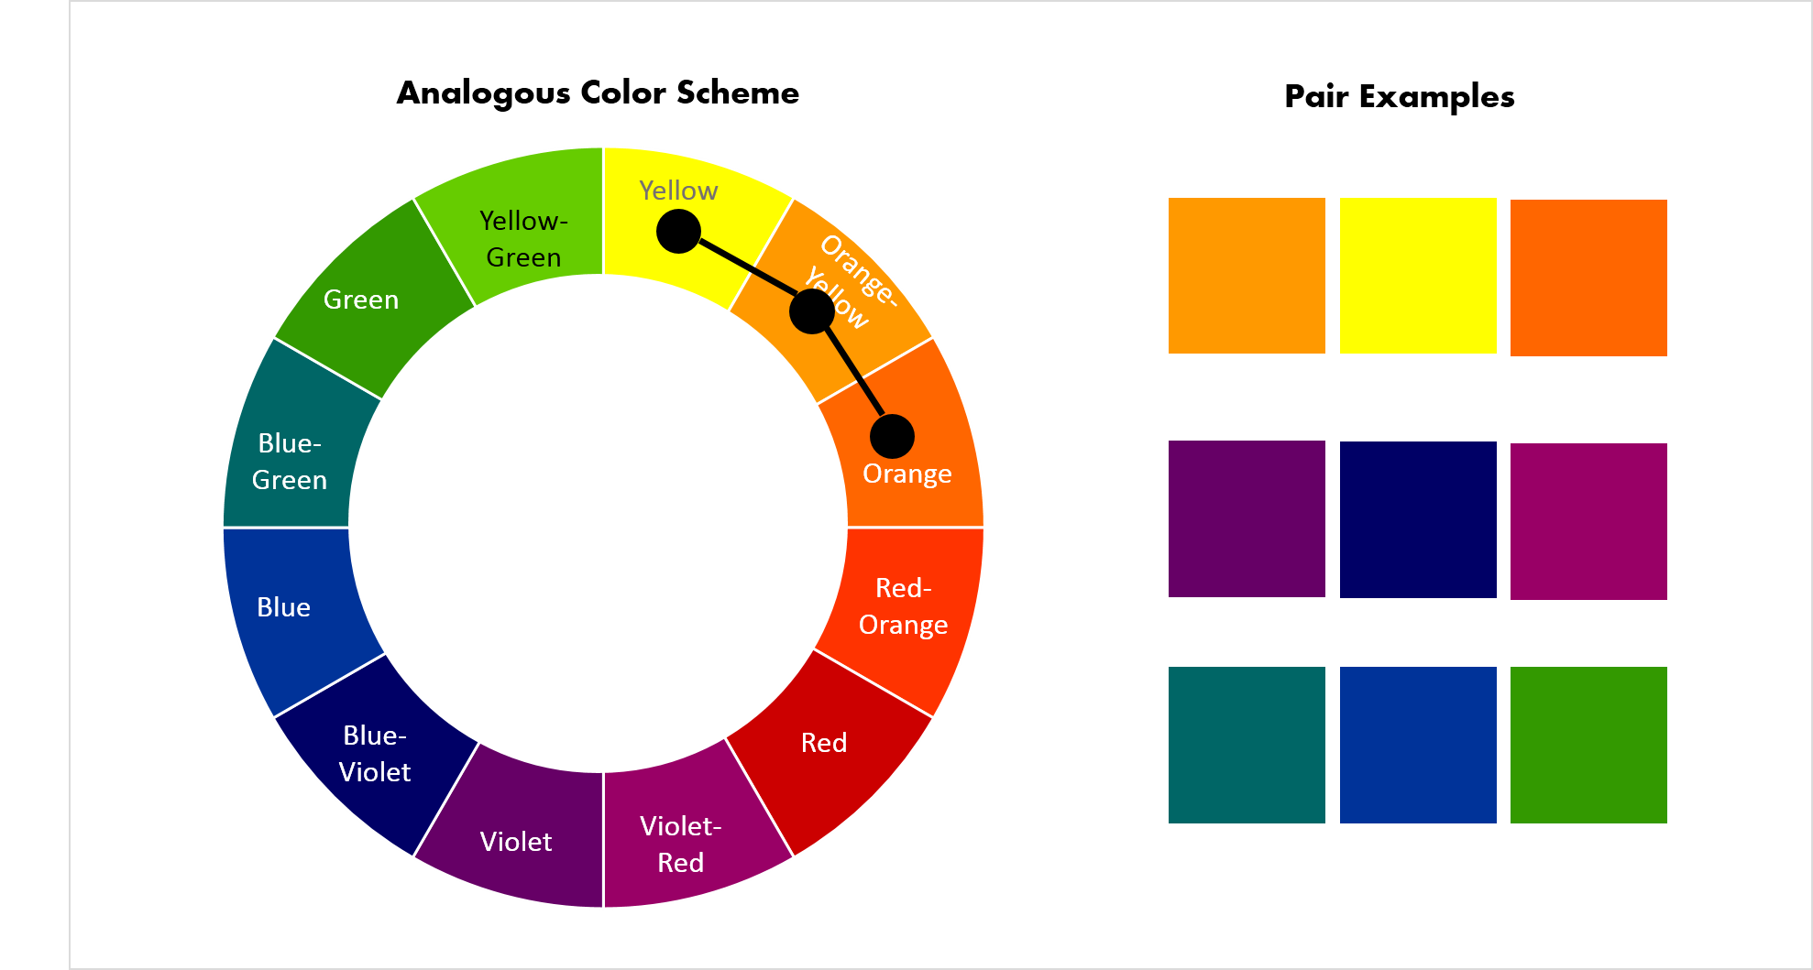
Choosing the Right Harmony
Goal | Harmony
Calm | Analogous
Elegant | Monochromatic
High Impact | Complementary
Playful | Triadic
Modern | Split Complementary
Notes:
As designers, we don't choose colour schemes randomly.
We choose them based on communication goals.
The colour harmony should support the message, audience, and emotional response we want users to experience.
Image from: https://sl.bing.net/cNMVZyfUH3k
How-to-use-Analogous-color-scheme.png (1978×1059)
https://www.slideteam.net/wp/wp-content/uploads/2015/09/How-to-use-Analogous-color-scheme.png

Slide 10
Choosing the Right Harmony
Notes:
As designers, we don't choose colour schemes randomly.
We choose them based on communication goals.
The colour harmony should support the message, audience, and emotional response we want users to experience.
Image from: https://sl.bing.net/cNMVZyfUH3k
How-to-use-Analogous-color-scheme.png (1978×1059)
https://www.slideteam.net/wp/wp-content/uploads/2015/09/How-to-use-Analogous-color-scheme.png

Slide 11
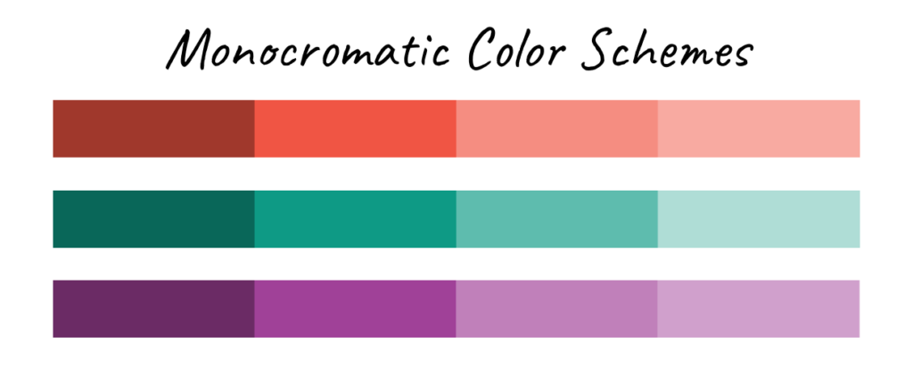
Choosing the Right Harmony
Goal | Harmony
Calm | Analogous
Elegant | Monochromatic
High Impact | Complementary
Playful | Triadic
Modern | Split Complementary
Notes:
As designers, we don't choose colour schemes randomly.
We choose them based on communication goals.
The colour harmony should support the message, audience, and emotional response we want users to experience.
Image from: https://sl.bing.net/fXPrslQDXyu
monochromatic-color-scheme-1-1024x412.png (1024×412)
https://www.imagely.com/wp-content/uploads/2024/08/monochromatic-color-scheme-1-1024x412.png

Slide 12
Choosing the Right Harmony
Goal | Harmony
Calm | Analogous
Elegant | Monochromatic
High Impact | Complementary
Playful | Triadic
Modern | Split Complementary
Notes:
As designers, we don't choose colour schemes randomly.
We choose them based on communication goals.
The colour harmony should support the message, audience, and emotional response we want users to experience.
Image from: https://sl.bing.net/fXPrslQDXyu
monochromatic-color-scheme-1-1024x412.png (1024×412)
https://www.imagely.com/wp-content/uploads/2024/08/monochromatic-color-scheme-1-1024x412.png

Slide 13
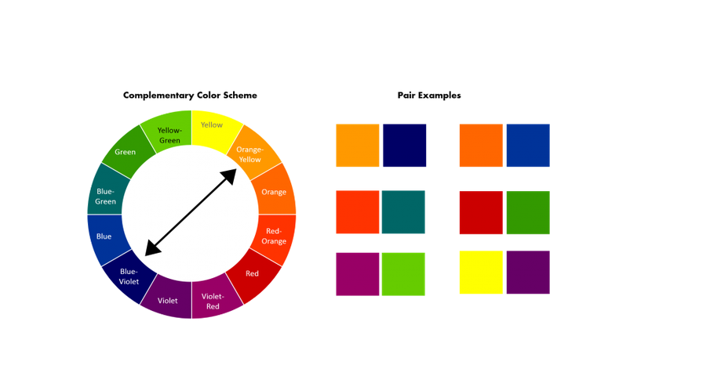
Choosing the Right Harmony
Goal | Harmony
Calm | Analogous
Elegant | Monochromatic
High Impact | Complementary
Playful | Triadic
Modern | Split Complementary
Notes:
As designers, we don't choose colour schemes randomly.
We choose them based on communication goals.
The colour harmony should support the message, audience, and emotional response we want users to experience.
Image from:
https://sl.bing.net/bY1EH1F0Jky
bing.com/newtabredir?url=https%3A%2F%2Fd3h2k7ug3o5pb3.cloudfront.net%2Fimage%2F2023-07-11%2F5d551c20-1f8e-11ee-b2fb-a93120ae2ac5.png

Slide 14
Choosing the Right Harmony
Goal | Harmony
Calm | Analogous
Elegant | Monochromatic
High Impact | Complementary
Playful | Triadic
Modern | Split Complementary
Notes:
As designers, we don't choose colour schemes randomly.
We choose them based on communication goals.
The colour harmony should support the message, audience, and emotional response we want users to experience.
Image from:
https://sl.bing.net/bY1EH1F0Jky
bing.com/newtabredir?url=https%3A%2F%2Fd3h2k7ug3o5pb3.cloudfront.net%2Fimage%2F2023-07-11%2F5d551c20-1f8e-11ee-b2fb-a93120ae2ac5.png

Slide 15
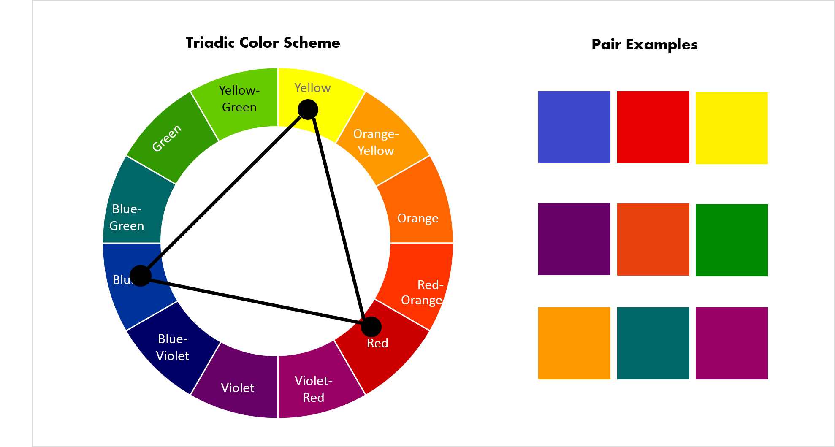
Choosing the Right Harmony
Goal | Harmony
Calm | Analogous
Elegant | Monochromatic
High Impact | Complementary
Playful | Triadic
Modern | Split Complementary
Notes:
As designers, we don't choose colour schemes randomly.
We choose them based on communication goals.
The colour harmony should support the message, audience, and emotional response we want users to experience.
Image From: https://sl.bing.net/hkm2tEwWfmK
https://siteimages.simplified.com/blog/triadic-color-pairing-examples.png?auto=compress&fit=scale&fm=png&h=548&w=1024
triadic-color-pairing-examples.png (1978×1059)

Slide 16
Choosing the Right Harmony
Notes:
As designers, we don't choose colour schemes randomly.
We choose them based on communication goals.
The colour harmony should support the message, audience, and emotional response we want users to experience.
Image From: https://sl.bing.net/hkm2tEwWfmK
https://siteimages.simplified.com/blog/triadic-color-pairing-examples.png?auto=compress&fit=scale&fm=png&h=548&w=1024
triadic-color-pairing-examples.png (1978×1059)

Slide 17
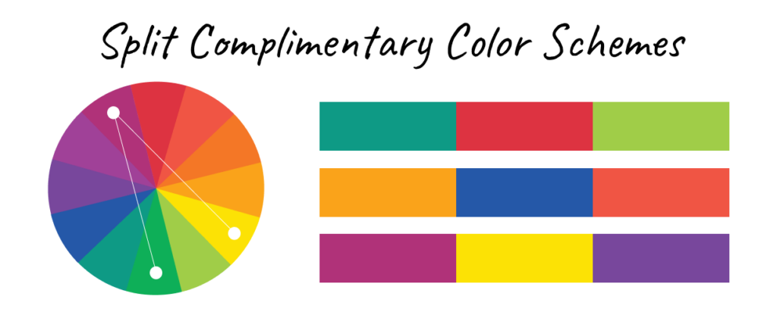
Choosing the Right Harmony
Goal | Harmony
Calm | Analogous
Elegant | Monochromatic
High Impact | Complementary
Playful | Triadic
Modern | Split Complementary
Notes:
As designers, we don't choose colour schemes randomly.
We choose them based on communication goals.
The colour harmony should support the message, audience, and emotional response we want users to experience.
Image from: https://sl.bing.net/dONlwjT0j48
split-complimentary-color-schemes-1-1-1024x412.png (1024×412)
https://www.imagely.com/wp-content/uploads/2024/08/split-complimentary-color-schemes-1-1-1024x412.png

Slide 18
Choosing the Right Harmony
Goal | Harmony
Calm | Analogous
Elegant | Monochromatic
High Impact | Complementary
Playful | Triadic
Modern | Split Complementary
Notes:
As designers, we don't choose colour schemes randomly.
We choose them based on communication goals.
The colour harmony should support the message, audience, and emotional response we want users to experience.
Image from: https://sl.bing.net/dONlwjT0j48
split-complimentary-color-schemes-1-1-1024x412.png (1024×412)
https://www.imagely.com/wp-content/uploads/2024/08/split-complimentary-color-schemes-1-1-1024x412.png

Slide 19
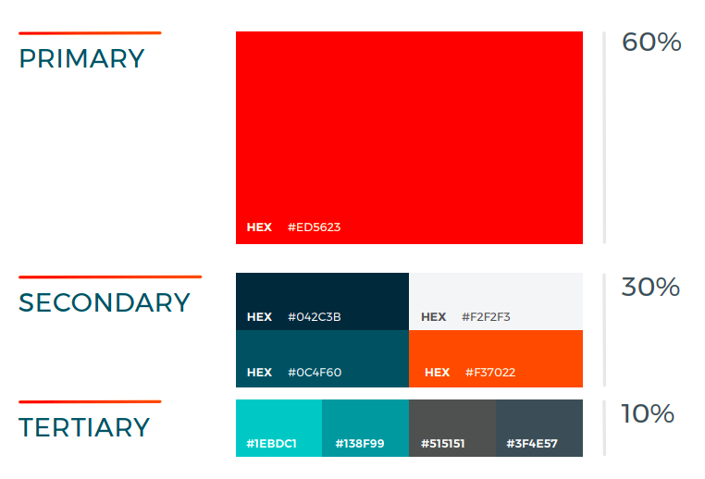
Colour Hierarchy & Accent Colours
60-30-10 Rule
60% dominant colour
30% secondary colour
10% accent/ tertiary colour
Notes:
Not every colour should have equal importance.
Designers create hierarchy by controlling colour volume.
A common guideline is the 60-30-10 rule.
Most of the design uses a dominant colour.
A supporting colour occupies less space.
An accent colour appears sparingly to attract attention.
This is one of the simplest ways to guide user attention.
Image from: web-style-guide-colors-1.png (762×518)
https://savvydigitaldesign.com/wp-content/uploads/2024/02/web-style-guide-colors-1.png
https://sl.bing.net/hyl3GnwrHB6

Slide 20
Colour Hierarchy & Accent Colours
Notes:
Not every colour should have equal importance.
Designers create hierarchy by controlling colour volume.
A common guideline is the 60-30-10 rule.
Most of the design uses a dominant colour.
A supporting colour occupies less space.
An accent colour appears sparingly to attract attention.
This is one of the simplest ways to guide user attention.
Image from: web-style-guide-colors-1.png (762×518)
https://savvydigitaldesign.com/wp-content/uploads/2024/02/web-style-guide-colors-1.png
https://sl.bing.net/hyl3GnwrHB6

Slide 21
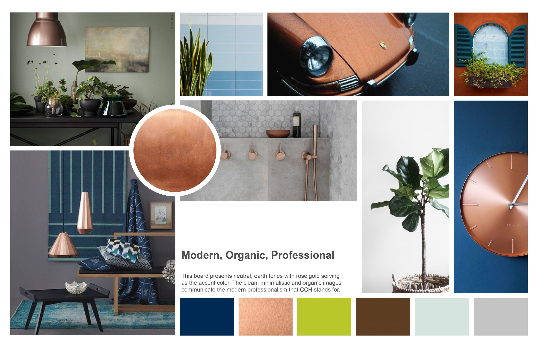
Mood Boards
Define audience
Define emotion
Gather imagery
Extract colours
Test combinations
Refine palette
Notes:
A mood board is often the bridge between strategy and design.
Before choosing colours, we determine the feeling we want to create.
We collect images, textures, typography, and inspiration.
Then we extract colours from those visuals and refine them into a working palette.
Image from: https://sl.bing.net/bzaXXzO5nRk
CCH_Moodboard_dft4b-scaled.jpg (2560×1656)
https://moonlightcreative.com/wp-content/uploads/2023/01/CCH_Moodboard_dft4b-scaled.jpg

Slide 22
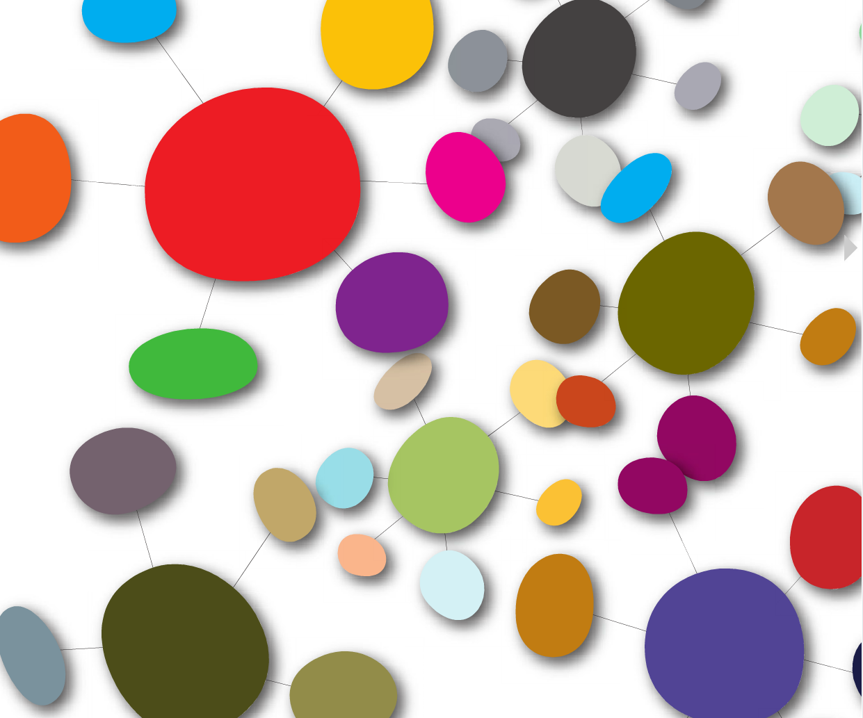

Building Palettes
Demo: creating palettes in Adobe Colour
Experiment with harmony and contrast

Slide 23
Assignment
Create three variations of the same design using different colour schemes (monochromatic, complementary, and analogous).
Pick a colouring page OR sketch your own layout
Write (or explain) a short reflection on how each colour scheme changes mood/message
Deliverables:
Three design variations (PDF, 8.5x11")
A comparison chart (half-page) describing the mood/impact of each scheme

Slide 24



Example 1
monochromatic
complementary
analogous
Notes:
I created these images using Canva

Slide 25



Example 2
Monochromatic
Complementary
Analogous
Notes:
I created these images using Canva

Slide 26
Reflection
Colour Scheme | How does this colour scheme impact mood? | How does this colour scheme impact emotion? | How does this colour scheme impact the message?
Monochromatic
Complimentary
Analogous

